Slide 1
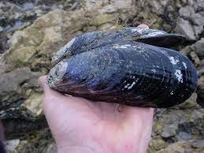
Preliminary Analysis of Population Structure in Mytilus californianus
Vanessa Garcia, Nate Jue and Eric Crandall
Notes:
Reduce to 6-8 slides

Slide 2
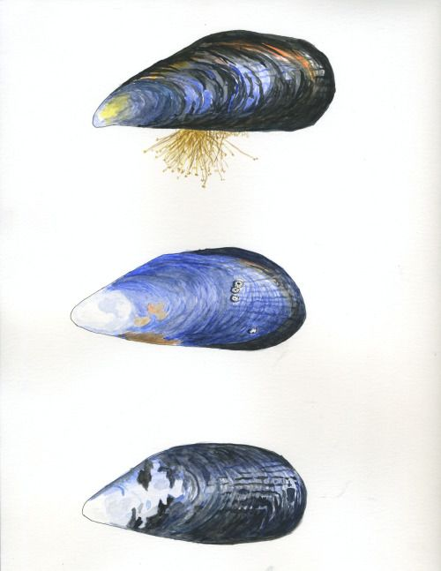

Mytilus californianus
Inhabit the coastal waters of western North America (Strathman 1985)
Spawn year-round (Suchanek 1981)
Larvae drift for up to 45 days (Suchanek 1981)
Life-span up to 50 years (Gosling 1992)
Hoskins, Rebecca. California Mussels (Mytilus californianus). Watercolor and Ink. [BeckinszIllustration.tumblr.com]. Accessed May 17, 2021.

Slide 3
Research Questions
How much genetic variation is observed between subpopulations?
Is there evidence of population structure?
Notes:
For Vanessa to re-state

Slide 4
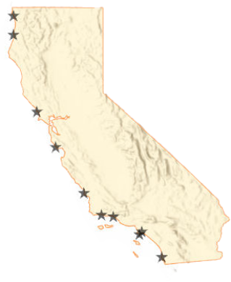
A metapopulation is a set of subpopulations which exchange genetic material (migration)
A higher rate of exchange is thought to result in less genetic differentiation between subpopulations
Population structure is the measure of genetic differentiation
Notes:
https://www.google.com/url?sa=i&url=https%3A%2F%2Fwww.pinterest.com%2Fpin%2F507921664207733377%2F&psig=AOvVaw2qcqMGiirBoj6yooD55Z1t&ust=1621291547964000&source=images&cd=vfe&ved=0CA0QjhxqFwoTCOCm-Oejz_ACFQAAAAAdAAAAABAD
For Vanessa to re-write

Slide 5
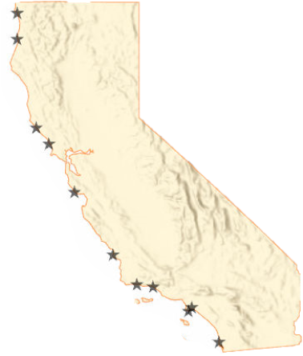
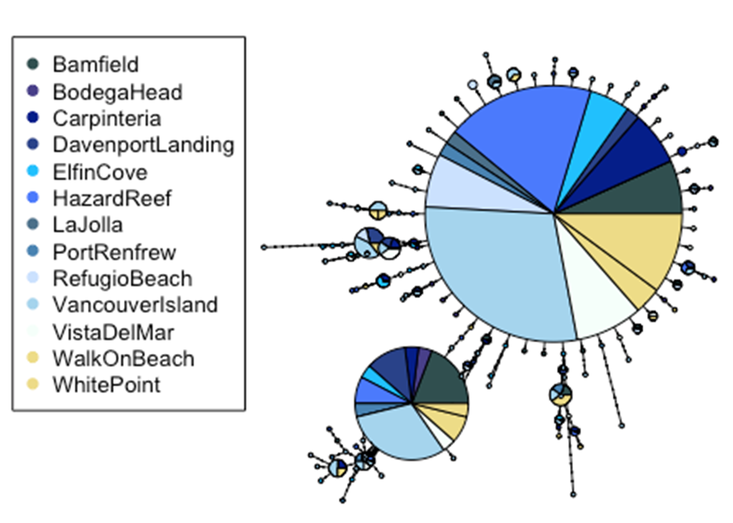
Data Collection & Processing
Enderts Beach n = 0
Isolated mitochondrial DNA from 138 mussels in 10% Chelex solution
Amplified cytochrome c oxidase (COI) gene with polymerase chain reactions (PCR)
Sequenced at MCLAB
Edited chromatograms and aligned sequences in Geneious software
Trinidad Head n = 0
Walk On Beach n = 7
Bodega Head n = 7
Davenport Landing n = 17
Hazard Reef n = 23
Refugio Beach n =16
Carpinteria n = 19
White Point n = 10
Vista Del Mar n = 19
La Jolla n = 8
Notes:
https://www.google.com/url?sa=i&url=https%3A%2F%2Fwww.pinterest.com%2Fpin%2F507921664207733377%2F&psig=AOvVaw2qcqMGiirBoj6yooD55Z1t&ust=1621291547964000&source=images&cd=vfe&ved=0CA0QjhxqFwoTCOCm-Oejz_ACFQAAAAAdAAAAABAD

Slide 6
Figure 1: A haplotype network which visualizes the number of base substitutions required to get from one haplotype to the next.
Notes:
Put populations in geographic order N to S

Slide 7
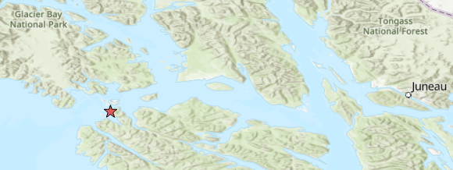
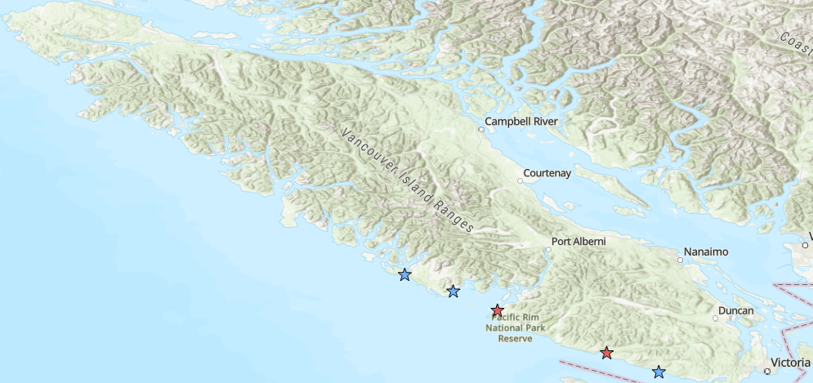
Additional Data
Criego-Prieto et al. 2015 n = 95
Marko et al. 2009 n = 57
Elfin Cove n = 19
Long Beach
Salmon Beach
Bamfield n = 23
Port Renfrew n = 15
China Beach
Notes:
Collapse to methods slide

Slide 8
Table 3: Analysis of molecular variance (AMOVA) results
 | Pt. Conception Hypothesis | Cape Mendocino Hypothesis | Addison et al. 2008 Southern Populations | Marko et al. 2010 Washington, BC, Alaska
Among Regions | -2.0e-3 | -8.6e-3
Among Populations within Regions | -2.0e-2 | -1.6e-2
Among Populations | -2.2e-2 | -2.5e-2 | -2.9e-3 | 4.0e-3
Notes:
Not entirely sure where marko value fits. Is it appropriate to have them in same table?

Slide 9
Models
Panmixia
Pt Conception
N-Island
Symmetric
Stepping-Stone
Southward
Stepping-Stone
(California Current)
Full
Stepping-Stone
20 replicates of 3 replicates of XXXXX steps for 20 independent estimates of Bezier-corrected thermodynamic marginal likelihood
Notes:
Add line map of North American west coast.

Slide 10
P = 0.006
Notes:
Gapped axis with gg.gap

Slide 11
Model | Marg_Like | Marg_Like_SD | Rank | lbf | modelprob
Island | -2266.94 | 7.41 | 6 | -276.5616 | 0.0000
Panmixia | -2133.31 | 4.73 | 2 | -9.2930 | 0.0095
Point_Conception | -2150.70 | 8.22 | 4 | -44.0650 | 0.0000
Stepping_Stone | -2136.54 | 7.91 | 3 | -15.7485 | 0.0004
Stepping_Stone_CC | -2128.66 | 5.67 | 1 | 0.0000 | 0.9901
Symmetrical_Stepping_Stone | -2163.39 | 9.23 | 5 | -69.4452 | 0.0000
Notes:
Sort by rank. Remove likelihood columns.

